Slide 1

THIS BUGS ME
The best part of engineering: fixing your mess
Charlie Morley-Wong 2024

Slide 2
DEBUGGING
Coding’s like 1% writing, 99% working out what’s gone wrong
Same goes for electronic design but with dire consequences
If it’s working right immediately, something’s up

Slide 3
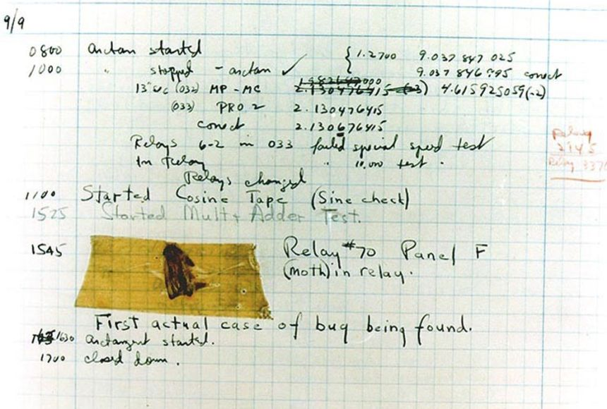
DEBUGGING IN REAL LIFE

Slide 4
DEBUGGING
It’s just problem solving, really
Take a step back and approach it step-by-step

Slide 5
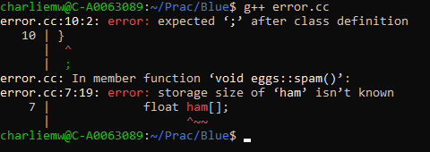
READ YOUR ERRORS

Slide 6
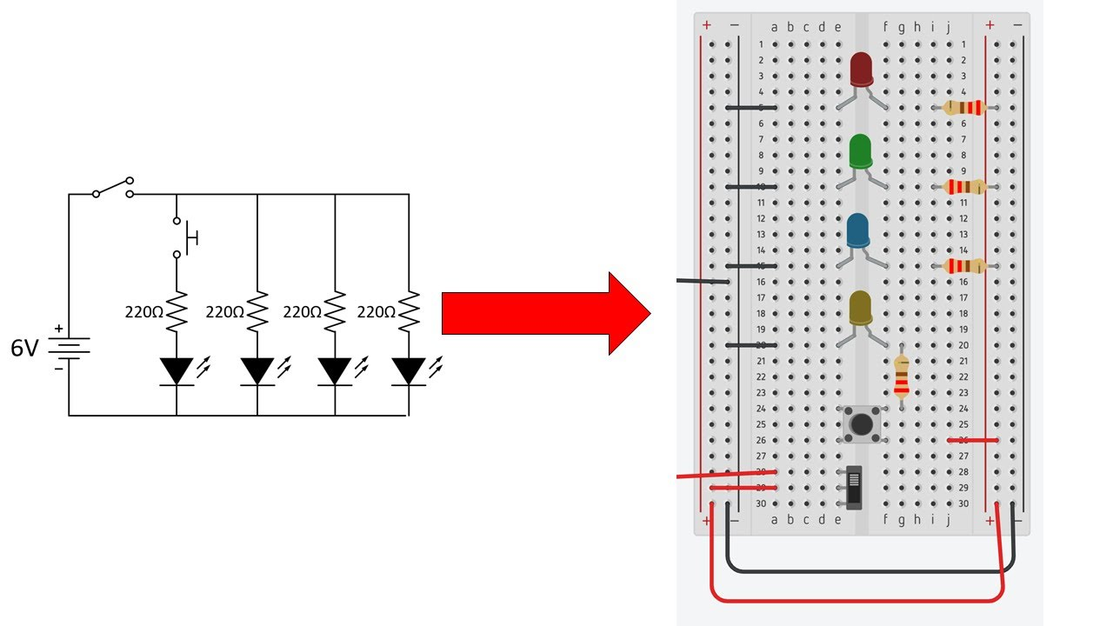
Check Models Match Diagrams
Retrieved from https://www.youtube.com/watch?v=LcvsIC6QLgw

Slide 7

Check Specific Code Blocks

Slide 8

Check Specific Code Blocks

Slide 9

Check Specific Code Blocks

Slide 10

Where to Go When You’re Stuck

